Slide 1

Azure iot
Group 4
Bousaeedi, Hosseini pour, MirMohammadSadeghi, Roghani

Slide 2
What is Azure IoT?
Azure IoT is a comprehensive solution to manage IoT devices.
You can analyze, store and integrate your data.
There are many sub-systems in Azure IoT like Azure IoT suit, Azure IoT central and etc.
Azure IoT is an efficient scalable solution for you to deploy your IoT device.

Slide 3
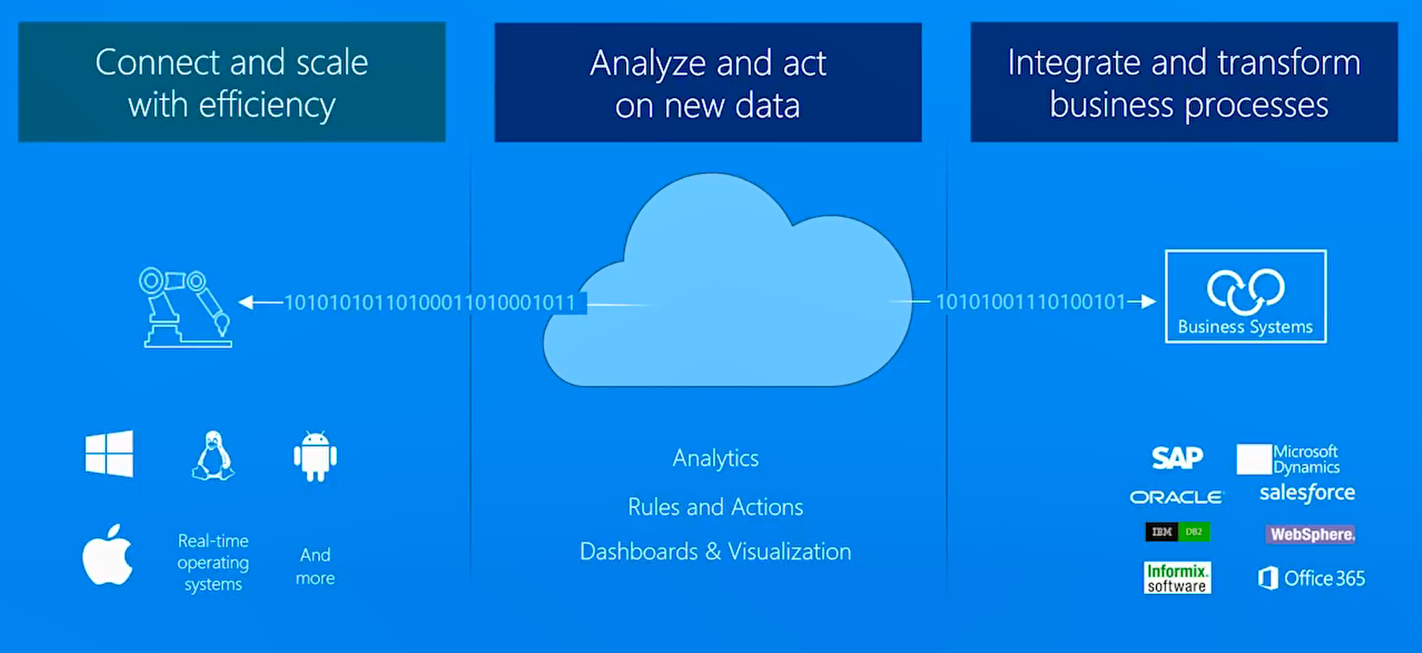
Benefits Of Using Azure

Slide 4
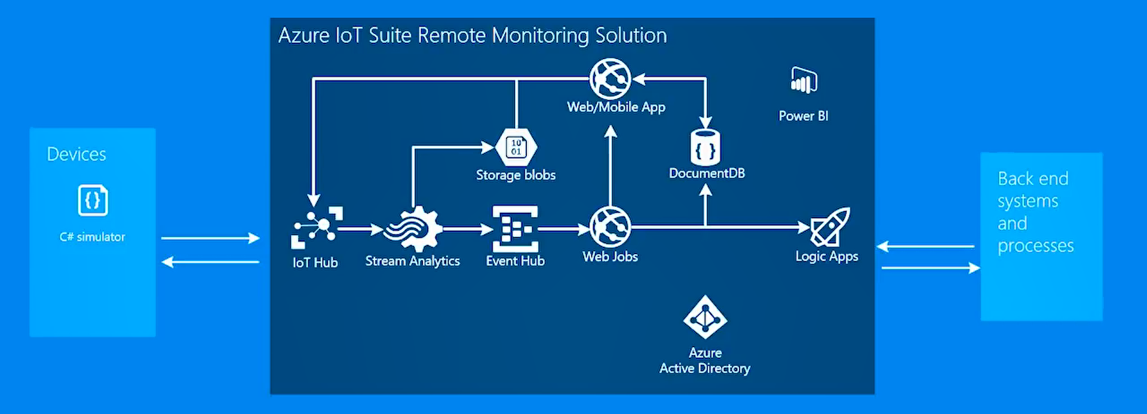
Microsoft Azure IoT Suit Architecture

Slide 5
Azure IoT Central
App templates that gives you a starting point so you can focus on your expertise.
Azure IoT Central consumes more than 30 Azure services and provides a single dashboard
You can connect multiple devices and monitor and manage all of them through Azure IoT central

Slide 6
Demo

Slide 7
Azure IoT Components
Azure IoT central (SAAS)
Azure IoT solution accelerator (BAAS)
Azure IoT hub
Azure digital twins
Azure time series insights
Azure sphere
Azure maps

